Slide 1
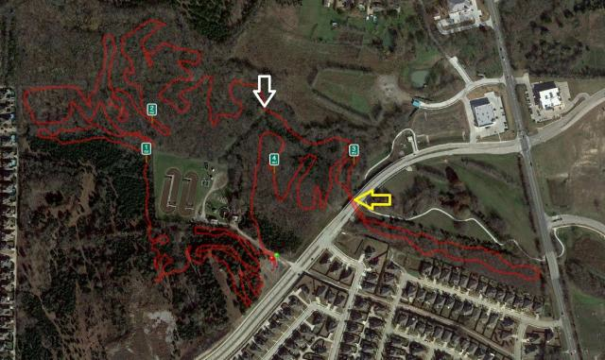
Bike Start
Bike Finish
YMCA
Leave the YMCA and ride on the shoulder up to Memorial Dr.
Turn right on Memorial Dr and make a hard right onto the hike/bike path going under Hwy 205
Enter Squabble Creek trail by turning right and complete Loops 1- 6 enter path as trail starts on left
Leave trail heading back down Lakeshore along the hike/bike concrete path (not on road)
Go under Lakeshore and Hwy 205 and continue on the path along Memorial
Travel along the Dam and through the fields back to the YMCA

